Slide 1
Feeding And Eating Disorder

Slide 2
Sub-types
Pica
Anorexia Nervosa
Bulimia Nervosa
Avoidant/Restricting Food Intake Disorder
Binge Eating Disorder
Rumination Disorder

Slide 3
PICA DISORDER DSM(V)
Submitted by: Syeda shafia Fatima
Roll no # 1155167
Submitted to miss Umme Rubab

Slide 4
Pica Disorder
Definition:
‘’The criteria for pica under DSM-5 is as follow; Persistent eating of non-nutritive substances for a period of at least one month. The eating of non-nutritive, non-food substances is inappropriate to the developmental level of the individual’’
Pica is sometimes linked to obsessive-compulsive disorder and impulse disorder because of the persistent dieting on non-nutritious food. Like those with OCD, individuals with pica are conscious of their behavior even though it is unhealthy and illogical behavior.

Slide 5
Symptoms:
Individuals who engage in pica may experience some of the same symptoms as a malnourished anorexic. Symptoms may include mineral deficiency, unhealthy nails and hair, and weight loss. They are at higher risk of more serious health issues such as abdominal pain, and intestinal and colonic obstruction. Pica is often co-morbid with other mental disorders and may be seen in autism spectrum disorder, schizophrenia, anorexia nervosa and non suicidal self-injury. Individuals feigning a factitious disorder may ingest nonfood items in order to imitate the symptoms of a more serious disorder.

Slide 6
Criteria
The criteria for pica under DSM-5 is as follows (APA, 2013):
Persistent eating of non-nutritive, nonfood substances for a period of at least one month.
The eating of nonnutritive, nonfood substances is inappropriate to the developmental level of the individual.
The eating behavior is not part of a culturally supported or socially normative practice.
If occurring with another mental disorder, or during a medical condition, it is severe enough to warrant independent clinical attention.

Slide 7
Risk Factors
The onset of pica is typically in childhood, although there is no age specification for developing the disorder. Pica is more common in areas of low economic status. Africa has a higher incidence of pica than western countries, for example. Some researchers have linked the odd cravings to nutritional deficiencies such as mineral deficiencies (Kumsar & Erol, 2013). Pregnant women experience pica, which may be part of pregnancy ‘cravings’ for different types of food.
Much of the research on pica has focused on its occurrence in those who have an intellectual disability. In fact, pica has a higher prevalence rate in individuals with intellectual disabilities than those with eating disorders (Karlsson, Råstam, & Wentz, 2013). Neglect and a lack of supervision are also risk factors, according to DSM-5. An abused child who is not adequately nourished may try and eat nonfood substances.

Slide 8
Cont…
Pica may also be associated with a mental disorder or brain damage. Brain imaging has revealed brain abnormalities prior to the development of pica symptoms. In one study, recent damage to the hippocampal area preceded the onset of pica (Rohde, Claussen, Kuechenhoff, Seifritz, & Schuepbach, 2013). As noted, there is a strong association between pica and obsessive-compulsive disorder.
Pica demonstrates the anxiety-relief-anxiety behavior pattern of anxiety disorders. A typical example is the case study of an adult male with a low-to-normal IQ who eats glass when feeling a high level of anxiety. After eating the glass, he reports feeling relief.
An individual engaging in pica may suffer from nutritional deficiencies, get infections, and die from the practice. Intestinal and colonic obstruction and infection are experienced. Pica is most often brought to the attention of doctors due to abdominal complaints

Slide 9
Pica Treatment
The classification of three new disorders under ‘Feeding and Eating Disorders’ in DSM-5 seeks to improve the clinical utility and thus treatment of eating disorders. Pica has not received a lot of research attention to date. Cognitive behavioral therapy (CBT) and family therapy are commonly used to treat eating disorders.
One treatment focus of pica is on those with intellectual and development disabilities who engage in a higher rate of pica behavior. Applied behavior therapy (ABT) is one of the most effective therapies; it is commonly and successfully applied with those with intellectual disabilities and behavioral problems, including those with autism and other disorders. ABT teaches new behavior by rewarding and reinforcing positive behavior and punishing undesired behavior.

Slide 10
Anorexia Nervosa
Presented By, Aqsa Ejaz
Roll No: (1155137)

Slide 11
Anorexia Nervosa
Anorexia nervosa often referred to simply as anorexia is an eating disorder characterized by low weight ,fear of gaining weight and a strong desire to be thin ,resulting in food restriction. Many people with anorexia see themselves as overweight even though they are in fact underweight. It also means nervous loss of appetite.

Slide 12
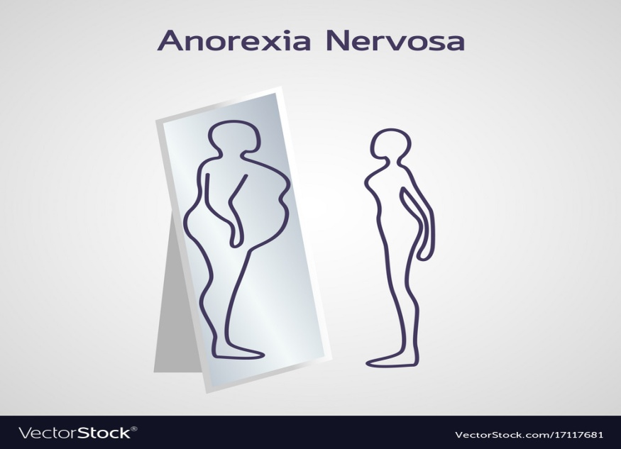
Types of Anorexia Nervosa
There are two types of anorexia. In the restricting type of anorexia, weight loss is achieved by restricting calories (following drastic diets, fasting, and exercising to excess). In the purging type of anorexia, weight loss is achieved by vomiting or using laxatives and diuretics.

Slide 13
Diagnostic Criteria for Anorexia Nervosa
Intense fear of gaining weight
Body Image Disturbance
Restriction of energy intake to requirements, leading to a significantly low body weight in the context of age,sex and physical health.

Slide 14
Signs and Symptoms
Makes frequent comments about feeling “fat” or overweight despite weight loss
Complains of constipation, abdominal pain, cold intolerance, lethargy, and/or excess energy
Denies feeling hungry
Develops food rituals (e.g., eating foods in certain orders, excessive chewing, rearranging food on a plate)
Cooks meals for others without eating
Consistently makes excuses to avoid mealtimes or situations involving food
Makes frequent comments about feeling “fat” or overweight despite weight loss
Complains of constipation, abdominal pain, cold intolerance, lethargy, and/or excess energy
Denies feeling hungry
Develops food rituals (e.g., eating foods in certain orders, excessive chewing, rearranging food on a plate)
Cooks meals for others without eating
Consistently makes excuses to avoid mealtimes or situations involving food

Slide 15
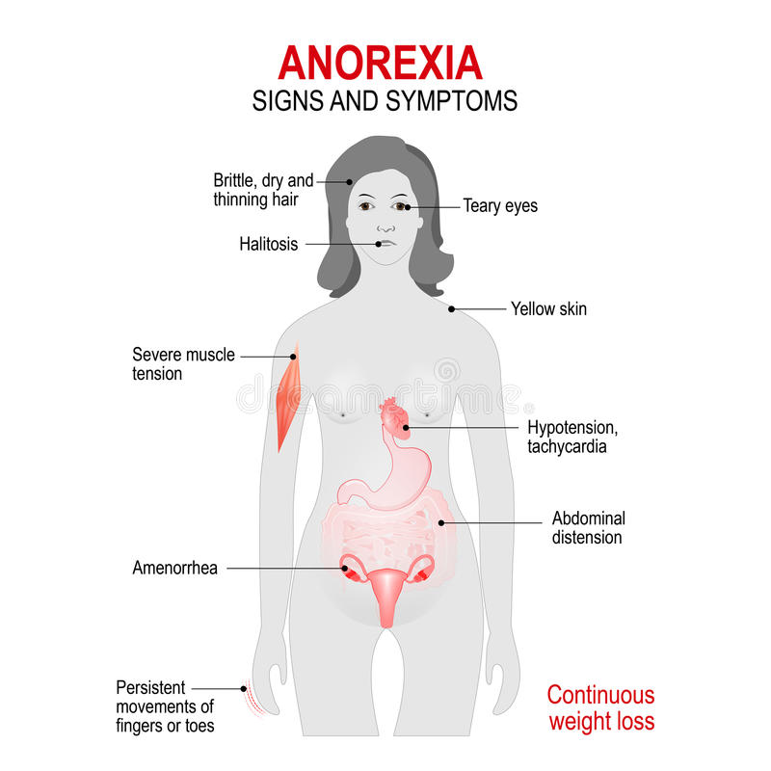

Slide 16
Causes of Anorexia Nervosa
Psychological Causes
Biological Causes
Social Causes

Slide 17
Treatment of Anorexia Nervosa
Family-based therapy. This is the only evidence-based treatment for teenagers with anorexia. Because the teenager with anorexia is unable to make good choices about eating and health while in the grips of this serious condition, this therapy mobilizes parents to help their child with re-feeding and weight restoration until the child can make good choices about health
CBT therapy. For adults, cognitive behavioral therapy — specifically enhanced cognitive behavioral therapy — has been shown to help. The main goal is to normalize eating patterns and behaviors to support weight gain. The second goal is to help change distorted beliefs and thoughts that maintain restrictive eating.

Slide 18
AVOIDANT/RESTRICTING FODD INTAKE DISORDER
DSM-5
Presented by: Qindeel Javaid
Roll No: 1155118

Slide 19
Avoidant/restricting food intake Disorder
Avoidant/restrictive food intake disorder (ARFID), previously known as selective eating disorder (SED), is a type of eating disorder, as well as feeding disorder, where the consumption of certain foods is limited based on the food's appearance, smell, taste, texture, brand, presentation, or a past negative experience with the food.
First appear in childhood or persist from Childhood to adulthood

Slide 20
Criteria
The DSM-V provides the following diagnostic criteria for ARFID:
A. An eating or feeding disturbance (e.g., apparent lack of interest in eating or food; avoidance based on the sensory characteristics of food; concern about aversive consequences of eating) as manifested by persistent failure to meet appropriate nutritional and/or energy needs associated with one (or more) of the following:
1. Significant weight loss (or failure to achieve expected weight gain or faltering growth in children). 2. Significant nutritional deficiency. 3. Dependence on enteral feeding or oral nutritional supplements. 4. Marked interference with psychosocial functioning.

Slide 21
criteria
B. The disturbance is not better explained by lack of available food or by an associated culturally sanctioned practice.
C. The eating disturbance does not occur exclusively during the course of anorexia nervosa or bulimia nervosa, and there is no evidence of a disturbance in the way in which one’s body weight or shape is experienced.
D. The eating disturbance is not attributable to a concurrent medical condition or not better explained by another mental disorder. When the eating disturbance occurs in the context of another condition or disorder, the severity of the eating disturbance exceeds that routinely associated with the condition or disorder and warrants additional clinical attention.

Slide 22
ARFID vs Anorexia and Blumia Nervosa
the primary difference between ARFID and anorexia is that ARFID lacks drive for thinnes
kids with ARFID typically don’t fear weight gain and don’t have a distorted body image.
Also, in ARFID, the problems that people have with eating are not related to underlying medical problems.

Slide 23
Etiology
Genetic factors
Eating disorders are familial illnesses, and temperamental traits predisposing individuals toward developing an illness are passed from generation to generation.
Psychological factors
Anxiousness and obsessive compulsive features tend to accompany eating disturbances, as do co-occurring mood and anxiety disorders.
Sociocultural factors
Cultural pressures to eat clean/pure/healthy as well as growing emphasis on food processing, sourcing, packing and environmental impact can influence food beliefs and intake.

Slide 24
Treatment
Cognitive behavioral therapy
Exposure therapy

Slide 25
Case study refusing solid food
Ms. B, age 11, is admitted to a pediatric medical inpatient unit for unintentional weight loss of 14 lb (15% total body weight) over the past month. She reports having 2 traumatic episodes last month: choking on a piece of cheese and having a swab specimen taken for a rapid strep test, which required several people to restrain her (the test was positive). Since then, she has refused to ingest solids, despite hunger and a desire to eat.
Ms. B reports diffuse abdominal pain merely “at the sight of food” and a fear of swallowing solids. She denies difficulty or pain upon swallowing, nausea, vomiting, or any change in bowel habits.
Her mother reports that, on the rare occasion that Ms. B has attempted to eat solid food, she spent as long as an hour cutting it into small pieces before bringing it to her mouth—after which she put the food down without eating. Her mother also witnessed Ms. B holding food in her mouth for “a very long time,” then spitting it out.
Ms. B says she is distressed about the weight loss and recognizes that her fear of solid food is excessive.

Slide 26
Binge Eating Disorder
DSM 5
Presented BY, Qindeel Javaid & Mobina Mushtaq
Roll no: 1155118 & 1155150

Slide 27
What is BED?
“Binge-eating disorder is a serious eating disorder in which an individual frequently consume unusually large amounts of food and feel unable to stop eating.”
Binge eating disorder is a common eating disorder where you frequently eat large amounts of food while feeling powerless to stop and extremely distressed during or after eating.
BED typically begins in late adolescence or early adulthood, often after a major diet.

Slide 28
Criteria
According to the DSM-5, diagnostic criteria for binge eating disorder include:
Recurrent episodes of binge eating. An episode of binge eating is characterized by both of the following:
Eating, in a discrete period of time (for example, within any two-hour period), an amount of food that is definitely larger than most people would eat in a similar period of time under similar circumstances
A sense of lack of control over eating during the episode (for example, a feeling that one cannot stop eating or control what or how much one is eating)

Slide 29
Cont…
The binge-eating episodes are associated with three (or more) of the following:
Eating much more rapidly than normal
Eating until feeling uncomfortably full
Eating large amounts of food when not feeling physically hungry
Eating alone because of feeling embarrassed by how much one is eating
Feeling disgusted with oneself, depressed, or very guilty afterwards
Marked distress regarding binge eating is present.
The binge eating occurs, on average, at least once a week for three months.
The binge eating is not associated with the recurrent use of inappropriate compensatory behavior (for example, purging) and does not occur exclusively during the course of anorexia nervosa, bulimia nervosa, or avoidant/restrictive food intake disorder.

Slide 30
Level of severity based on frequency of episodes
MILD: 1-3 binge eating episodes per week
Moderate: 4-7 binge eating episodes per week
Severe: 8-13 binge eating episode per week
Extreme: 14 or more binge eating episodes per week.

Slide 31
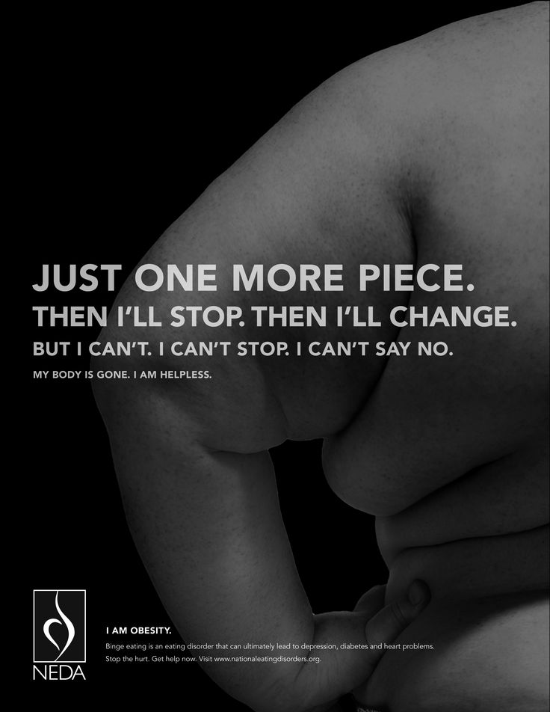
CYCLE
It becomes a vicious cycle: eating to feel better, feeling even worse, and then turning back to food for relief.
People with BED are mostly Obese.

Slide 32
Not all people with obesity meet the criteria of BED
Binge episodes
Feeling loss of control over their eating
Include intense feeling of embarrassment, guilt and shame around binge eating episodes
Potential weight gain
Just a physical issue that all ages and populations struggle with.
BED
OBESITY

Slide 33
comorbidity
Mood disorders
Anxiety disorders
Substance use disorder.

Slide 34
Prevalence
Females 1.6% - Males 0.8%
More prevalent among females and among individuals seeking weight loss treatment.

Slide 35
Clinical case
Amy, a 27 year old African-American woman described a life long struggle with her weight. She was described as ‘chubby’ as a child and peers often called her “fatty”. She went on several diets as a child, but none of them were successful. Currently, Amy is 5 feet4 inches tall and weighs 212 pounds (BMI of 35). Amy has experienced several episodes of bingeing at age 18, when she first left home for college. After being left out from a social group on campus, she retreated to her dorm room alone, where she ate two large pizzas and a bag of Doritos. After the binge she felt very full and went to sleep. After that first binge she found herself doing this as often as twice a week throughout college. She always not hungry when she binged, but even though she felt extremely full, she couldn’t stop eating. Afterwards, she felt ashamed and angry at herself for having eaten so much. She gained 70 pounds during her college years.
Amy reported that she currently binges at least once a week typically, when she has had a very stressful day at work. She has recently confined in a friend about her trouble eating and her friend recommended that she seek treatment at local university mental health care.

Slide 36
Causes of BED
Exact cause is still unknown but researchers are beginning to understand the factors leading to its development
These factors are
Biological : Biological abnormalities such hormonal changes or genetic mutations

Slide 37
Causes
Psychological : Strong correlation has been established between DEPRESSION and binge eating disorder. Body dissatisfaction, low self esteem and difficulty coping with feelings may also trigger BED.
Socio-cultural : Traumatic situations such as history of sexual abuse
Socially isolated individual
Social pressure to be thin
Negative critical comments about their bodies and weight can lead to BED.

Slide 38
Treatment of Binge Eating Disorder
Psychotherapy Helps changing your unhealthy habits to healthy one. It could be as group session or individually.Theapist helps you explore your pattern of thoughts , feelings and behavior that leads to BED.
Offered about 16 weekly sessions over 4 months
For a group session 90 minutes
One to one individual session takes 60 minutes
Cognitive Behavioral Therapy
Helps changing your negative feelings about your body or depressed mood

Slide 39
Psychotherapy
Interpersonal psychotherapy
It focuses on your relationship with others. It reduces BED that may be triggered by problematic relationships and unhealthy communication skills with them.
Dialectical behavior therapy
This type of therapy helps you tolerate your stress , regulate your emotions and improve your relationships.

Slide 40
Medications
Several type of medication may help reduce symptoms
Topiramate
An anticonvulsant used to control seizures has also been found to reduce BED. However there are some side effects (dizziness,insomina,nervousness) that should be discussed with your medical care provider before taking it.
Antidepressant
Its not clear how they reduce BED nut it may relate to how they affect certain brain chemicals associated with mood.
It is rarely prescribed for children or young people under 18.

Slide 41
Effects of BED
It leads to variety of physical ,emotional and social problems. Such as
Stress
Health issues
Insomnia
Suicidal thoughts
Depression
Anxiety
Substantial weight gain (obesity)
Sleep apnea ( breathing stops many times during sleep or night )
High blood pressure

Slide 42
Rumination Disorder
Presened By, Mobina Mushtaq
Roll no: 1155150

Slide 43
RUMINATION DISORDER
It is an eating disorder in which the individual repeatedly and unintentionally spit up (regurgitate) undigested/partially digested food from the stomach, rechew it and then either reswallows it or spit it out.

Slide 44
SYMPTOMS/COMPLICATIONS
The main symptom of this disorder is the repeated regurgitation of undigested food. Regurgitation typically occurs between a half hour to two hours after eating. People with this condition regurgitate every day and after almost every meal.
Other symptoms may include:
bad breath
weight loss
stomach aches or indigestion
tooth decay
dry mouth or lips
Social impairment
Embarrassment
Signs and symptoms of rumination disorder are the same in both children and adults. Adults are more likely to spit out regurgitated food. Children are more likely to rechew and reswallow the food.

Slide 45
DIAGNOSTIC CRITERIA
According to DSM V
The individual consistently regurgitates food over a period of 1 month or longer. The food is re-chewed, re-swallowed, or spat back out.
The aforementioned action cannot be attributed to a gastrointestinal condition or other medical condition.
This eating disturbance is not solely a factor of another eating disorder the individual faces, such as anorexia nervosa, bulimia nervosa, or binge-eating disorder.
And if it occurs within the realm of another mental illness (like generalized anxiety disorder, for example) or a neurodevelopment disorder (like intellectual disability, for example), the behavior must be sufficiently severe to demand independent clinical attention.

Slide 46
CHANGES FROM DSM IV
The DSM has moved three disorders ( rumination disorder, avoidant/restrictive food intake disorder and pica ) that were contained within the DSM-IV chapter, “Disorders Usually First Diagnosed in In-fancy, Childhood, or Adolescence” to EATING DISORDERS as the DSM-5 no longer has a childhood disorders chapter.

Slide 47
PREVALENCE & COMORBIDITY
PREVALENCE
Many patients find pleasure in the habitual regurgitating behavior related to rumination disorder. Some describe it as soothing, or a coping strategy for dealing with anxiety. Still, many patients are aware that the behavior is socially unacceptable and try to hide it. Because of this, the prevalence of Rumination Disorder is difficult to determine (Hartmann, et al., 2012). Although it is estimated to occur in 6-10% of institutionalized patients, prevalence among the general population is unknown.
COMORBIDITY
Rumination disorder may occur with other mental disorders, such as generalized anxiety disorder, depression and intellectual development disorder.

Slide 48
DIAGNOSIS
There’s no test for rumination disorder. Your doctor will perform a physical exam and ask you to describe you or your child’s symptoms and medical history. The more detailed your answers, the better. A diagnosis is mostly based on the signs and symptoms you describe. People with rumination disorder often don’t have other symptoms such as true vomiting or an acid sensation or taste in their mouth or throat. Rumination disorder is often misdiagnosed and mistaken for other conditions. More awareness is needed to help people with the condition and doctors identify symptoms.

Slide 49
CAUSES
Researchers don’t completely understand what causes rumination disorder.
Regurgitation is thought to be unintentional, but the action required to regurgitate is likely learned. For example, someone with rumination disorder may unknowingly never have learned how to relax their abdominal muscles. Contracting the diaphragm muscles can lead to regurgitation.
More research is needed to better understand this condition.

Slide 50
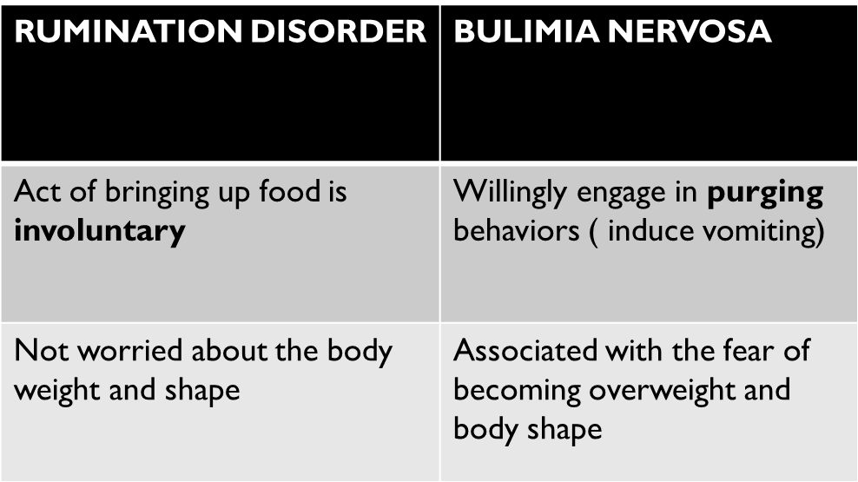
DIFFERENCE FROM BULIMIA NERVOSA

Slide 51
TREATMENT
Treatment for rumination disorder is the same in both children and adults. Treatment focuses on changing the learned behavior responsible for regurgitation.
The simplest and most effective treatment for rumination disorder in children and adults is diaphragmatic breathing training. It involves learning how to breathe deeply and relax the diaphragm. Regurgitation cannot occur when the diaphragm is relaxed.
Apply diaphragmatic breathing techniques during and right after meals. Eventually, rumination disorder should disappear.

Slide 52
CONT…
Other treatments for rumination disorder
can include:
changes in posture, both during and right after a meal
removing distractions during meal times
reducing stress and distractions during meal times
psychotherapy
There is currently no medication available for rumination disorder.

